Slide 1

BY: PEACE NGOZI AGHEDO

Slide 2
Assumptions
Marketing Objective: You are running an advertising campaign with the goal of signing up students for the Digital Marketing Nanodegree
Cost: The cost of the degree is $999
Profit: For the purpose of this assignment, assume a profit margin of 30%, meaning that Udacity makes $299 in profit per student that signs up.
Campaign: We want to aggressively grow the program, but, we want to do it without losing money.

Slide 3
Formulas:
Conversion Assumption: 0.2% Conversion via Landing page
Calculating #of Sign Ups: Clicks to the landing page *0.002 = # of Student Sign Ups
Note: Please round to the nearest whole number
CPA: Cost of Campaign/# sign ups = CPA
Note: Please round to the nearest cent
ROI: [(299 Profit) - CPA] * # of Student Sign Ups = ROI

Slide 4
Part 1
Evaluate a Display Image Campaign

Slide 5

Display Image Campaign: Overall Results
Find below the overall results of the Display Image Campaign targeting the Affinity Audience. The Affinity Audience consisted of Business Professionals Social Media Enthusiasts.

Slide 6
Results:
Calculate the ROI
What was the overall ROI of the campaign? Was it Positive or Negative?
The overall ROI of the campaign was +$149.04 hence the campaign was positive.
Creative | Clicks | Impressions | CTR | Avg CPC
Campaign Results | 1,243 | 200,957 | 0.62% | $0.36
Cost | Conversion Rate | # New Students | CPA | ROI +/-
$448.95 | 0.2% | 2 | $224.48 | +149.04

Slide 7
How would you optimize this campaign?
Suggestion 1: I’ll suggest A/B testing be conducted to ascertain if a change in the display picture added to the campaign will positively affect the campaign’s performance by attracting the interest of more audience, thereby increasing the traffic to the site.
Suggestion 2: I’ll suggest a change in the Ad target audience. The target audience used initially should be expanded to reach more persons of different age groups, races and background.
Suggestion 3: I’ll also suggest a change of the Ad Headline. The headline should be structured in respect of the target audiences so they can easily relate to the topic when they see it. The headline can be rephrased to “Acquire in-Demand Business tech Skills”. This will interest Business professionals who are social media enthusiasts.

Slide 8
Part 2
Evaluate a Display Image Campaign

Slide 9
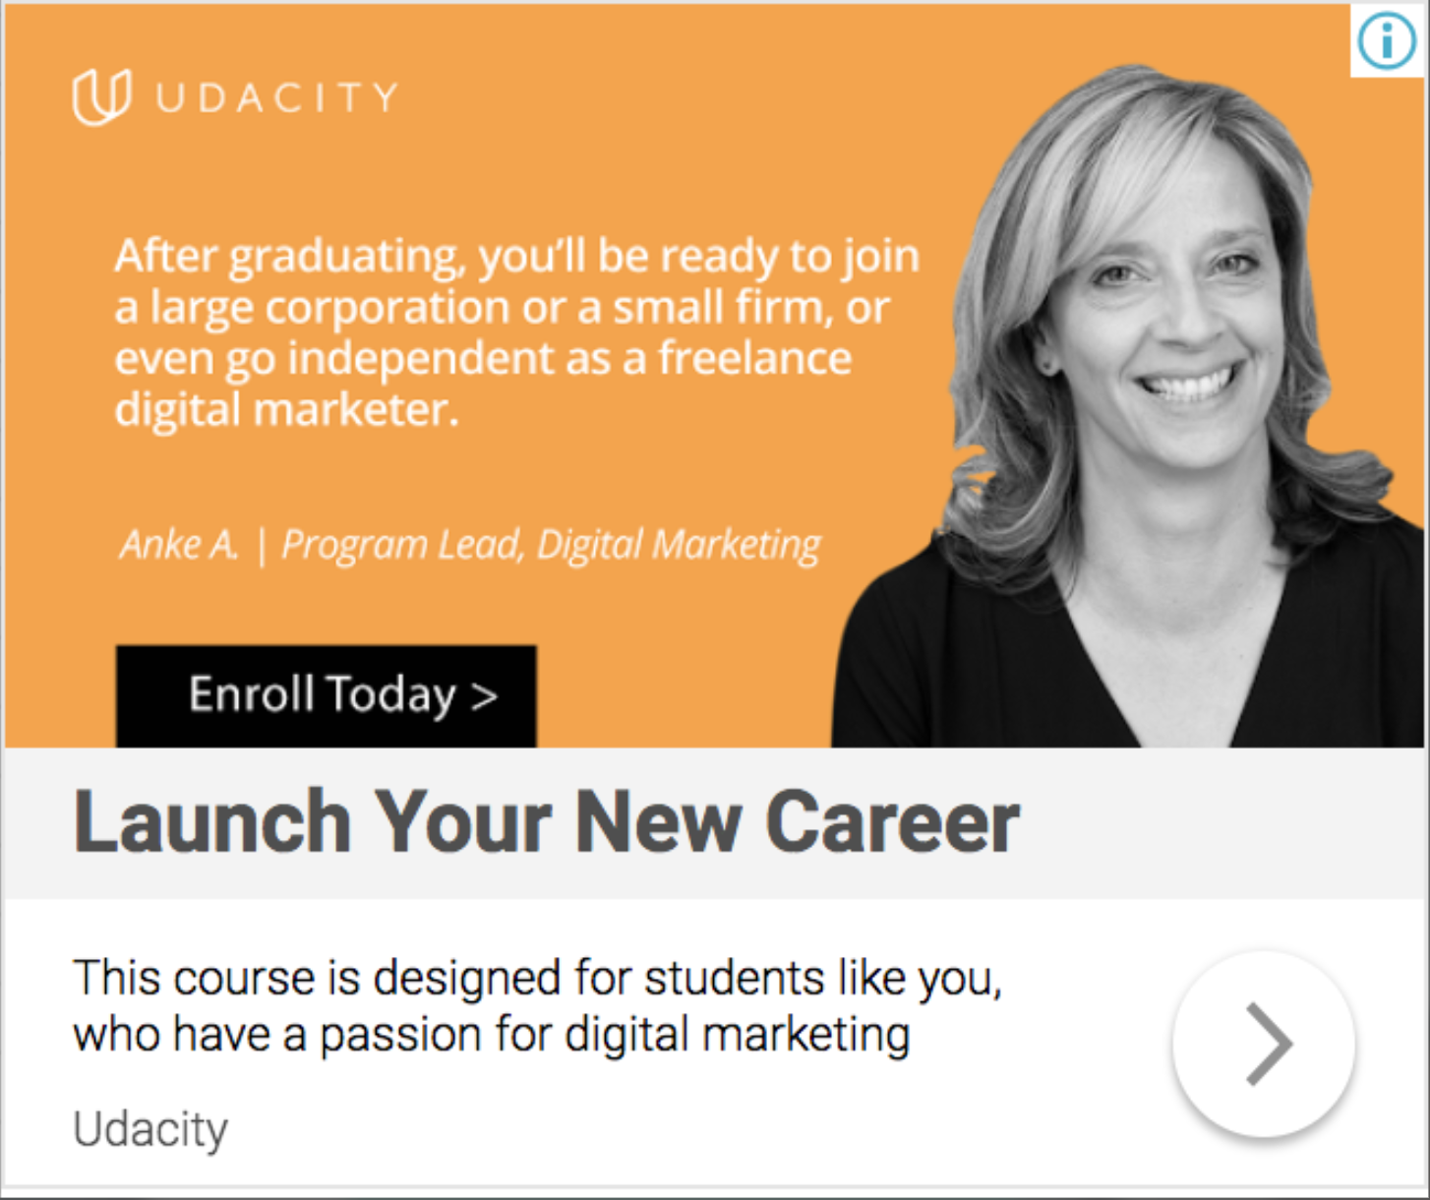
Display Image Campaign: Site Targeting Find below the overall results of the Display Image Campaign targeting placements (site targeting). This audience consists of the Digital Marketing partners’ landing pages.

Slide 10
Results: Calculate the ROI
What was the overall ROI of the campaign? Was it Positive or Negative?
The overall ROI of the campaign was +$67.01. hence the campaign was positive.
Creative | Clicks | Impressions | CTR | Avg CPC
Campaign Results | 407 | 67,833 | 0.6% | $0.57
Cost | Conversion Rate | # New Students | CPA | ROI +/-
$231.99 | 0.2% | 1 | $231.99 | +$67.01

Slide 11
How would you optimize this campaign?
Suggestion 1: I’ll suggest a change in the Ad target audience. The target audience used initially should be expanded to reach more persons of different age groups, races and background.
Suggestion 2: I’ll suggest A/B testing be conducted to ascertain if a change in the display picture added to the campaign will positively affect the campaign’s performance by attracting the interest of more audience, thereby increasing the traffic to the site. I suggest the picture of both a younger and older person be added to show that it is not for only the old but for all age group.
Suggestion 3: I’ll also suggest a change of the Ad Headline. The headline should be structured in respect of the target audiences so they can easily relate to the topic when they see it. The headline can be rephrased to “Launch a New Career in Digital Marketing”. This will interest Business professionals who are social media enthusiasts.

Slide 12
Part 3
Evaluate a Display Image Campaign

Slide 13

Display Image Campaign: Overall Results
Review below the overall results of the Display Image Campaign targeting visitors to the Digital Marketing Nanodegree Program landing page

Slide 14
Results: Calculate the ROI
What was the overall ROI of the campaign? Was it Positive or Negative?
The overall ROI of the campaign was +$64.5. hence the campaign was positive.
Creative | Clicks | Impressions | CTR | Avg CPC
Campaign Results | 670 | 109,994 | 0.61% | $0.35
Cost | Conversion Rate | # New Students | CPA | ROI +/-
$234.50 | 0.2% | 1 | $234.50 | +$64.5

Slide 15
How would you optimize this campaign?
Suggestion 1: I’ll also suggest a change of the Ad Headline. The headline should be structured in respect of the target audiences so they can easily relate to the topic when they see it. The headline can be rephrased to “Gain a Degree in Digital Marketing”. This will interest Business professionals who are social media enthusiasts.
Suggestion 2: I’ll suggest a change in the Ad target audience. The target audience used initially should be expanded to reach more persons of different age groups, races and background.
Suggestion 3:I’ll suggest A/B testing be conducted to ascertain if a change in the display picture added to the campaign will positively affect the campaign’s performance by attracting the interest of more audience, thereby increasing the traffic to the site.

Slide 16
Part 4
Results, Analysis, and Recommendations

Slide 17
Which campaign performed the best? Why?
Amongst all three campaign, the best performing campaign was Campaign 1 -Affinity Audience). This is based on the fact that It had the highest number of landing site clicks of 1247 compared to campaigns two and three that had 407 and 670 respectively.
Also, Campaign 1 yields more profit to Udacity since it had the highest number of signup students- 2 (2x299=$598) compared to the other two campaigns that had just 1 signup student each, hence a lower profit ($299).
Also, the ROI for campaign 1 was positive and very high (+$149.05) compared to campaigns two and three that had +$67.01 and +$64.5 respectively.

Slide 18
Recommendations for future campaigns
I’ll suggest A/B testing be conducted to ascertain if a change in the display picture added to the campaign will positively affect the campaign’s performance by attracting the interest of more audience, thereby increasing the traffic to the site. Instead of using the picture of an old woman, I suggest the pictures of both a younger and older person of different gender be added to show that it is not for only the old and one gender but for all age group and all gender.
I’ll suggest a Call-to-action button named “Register now” be added to the campaign to carry interested people to the landing site.
I suggest that more focus be put on Ad Campaign One – (Affinity Audience) due to It’s high performance. The budget should be increased since it shows more prospect of achieving the campaign’s objective.

